Slide 1
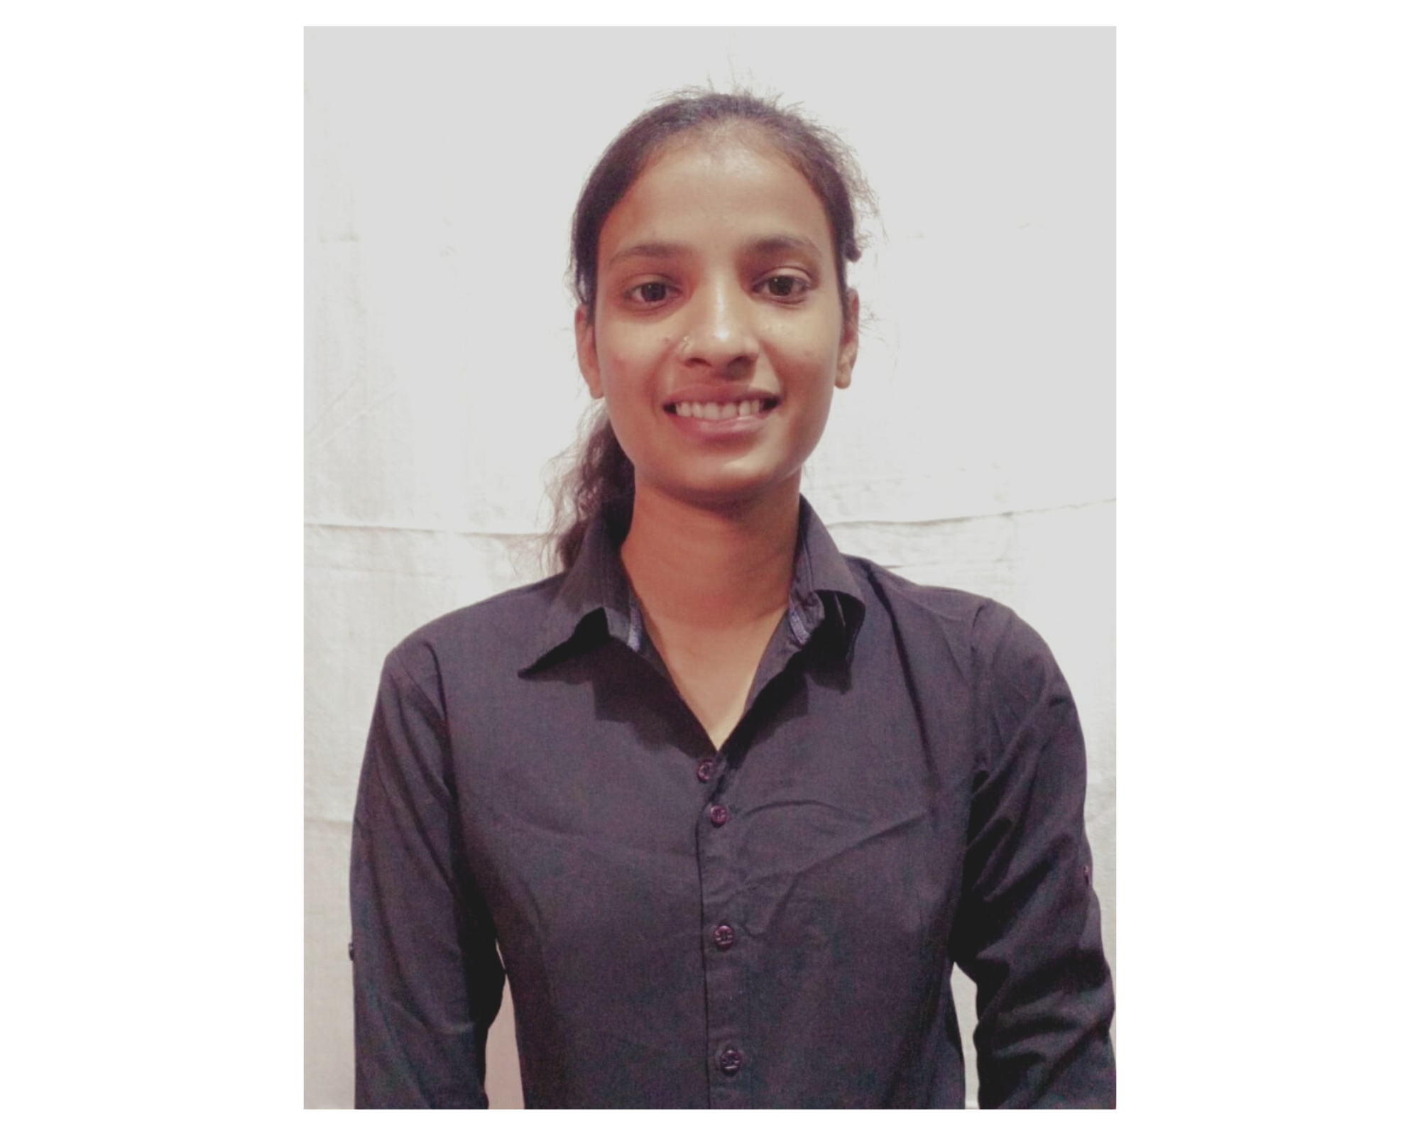

Ruchita Prakash Umbarkar
Bachelor of Technology,
Civil Engineering : 2018-22
Analyst/Software Engineer
Skills
MUMBAI
C# | Basics, OOPS, Exception Handling ,Arrays ,Collection and Generics.
.NET Framework | ADO.NET, .NET 6 WEB API, Entity Framework , ASP .NET with MVC5.
Database | SQL Server.
Tools | GIT,POSTMAN, VISUAL STUDIO,SSMS.
UI Technology | HTML5 ,CSS, JavaScript, Typescript & Angular
Add On Skills | Communication Skills, Team Management
ruchita-prakashrao.umbarkar@capgemini.com
+91 7030222860
A4
Full Stack Developer
Proficient in C#, , SQL Server, ADO.NET, Entity Framework, ASP.NET MVC with WEB API
Worked on HTML5, CSS, JavaScript , TypeScript and Angular.
Understanding of RDBMS concepts using SQL Server.
Practical understanding of C#, OOP’s and SQL concepts using Visual Studio and SQL Server.
Worked on Git and GitHub.
GitHub Link LinkedIn
Developed a WEB APPLICATION called Roll Off as part of case study which include roll off system of employee with status.
TECHNOLOGIES USED:
Frontend angular, HTML, Bootstrap.
Backend ASP.NET Web Api
Database- SQL Server
Tools used: Visual Studio 2019, VS Code, SSMS, Swagger

